Slide 1
Employee Data Analysis using Excel
STUDENT NAME: S. Dharshini
REGISTER NO: 312207741
DEPARTMENT:Commerce
COLLEGE: The Quaide Milleth College For Men

Slide 2
PROJECT TITLE
Employee Performance Analysis using Excel

Slide 3

AGENDA
Problem Statement
Project Overview
End Users
Our Solution and Proposition
Dataset Description
Modelling Approach
Results and Discussion
Conclusion
3/21/2024 Annual Review

Slide 4
PROBLEM STATEMENT
"Your company wants to evaluate the performance of its employees over the past year to identify high performers, areas needing improvement, and overall trends. You have data on employee performance, including metrics such as productivity, quality of work, attendance, and adherence to deadlines. Your task is to use Excel to analyze this data and generate insights that can inform performance reviews and decision-making processes

Slide 5
PROJECT OVERVIEW
Analyze employee performance by collecting and organizing data in Excel, calculating key metrics, and visualizing results through charts. Summarize findings in reports and recommend actions for improvement. The project spans 4 weeks with a focus on data preparation, analysis, visualization, and reporting.
.

Slide 6
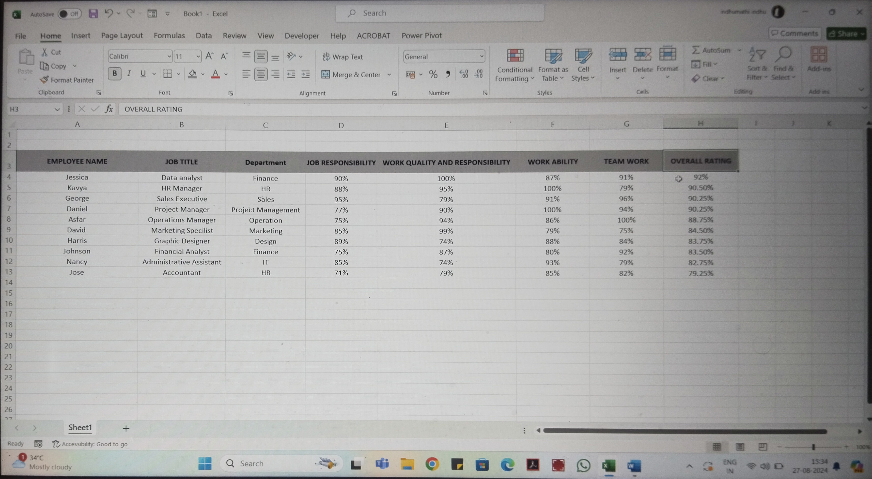

Slide 7
WHO ARE THE END USERS?
End users of employee performance analysis in Excel include HR managers, team leaders, senior management, and employees. HR managers and team leaders use it to evaluate and support performance, senior management for strategic decisions, and employees for self-assessment and goal setting.

Slide 8
OUR SOLUTION AND ITS VALUE PROPOSITION
Our Excel-based employee performance analysis solution offers customizable metrics and reporting tools, leveraging familiar interfaces and built-in analytics for comprehensive, cost-effective performance tracking. It integrates diverse data sources, providing a flexible, budget-friendly approach to performance evaluation.

Slide 9
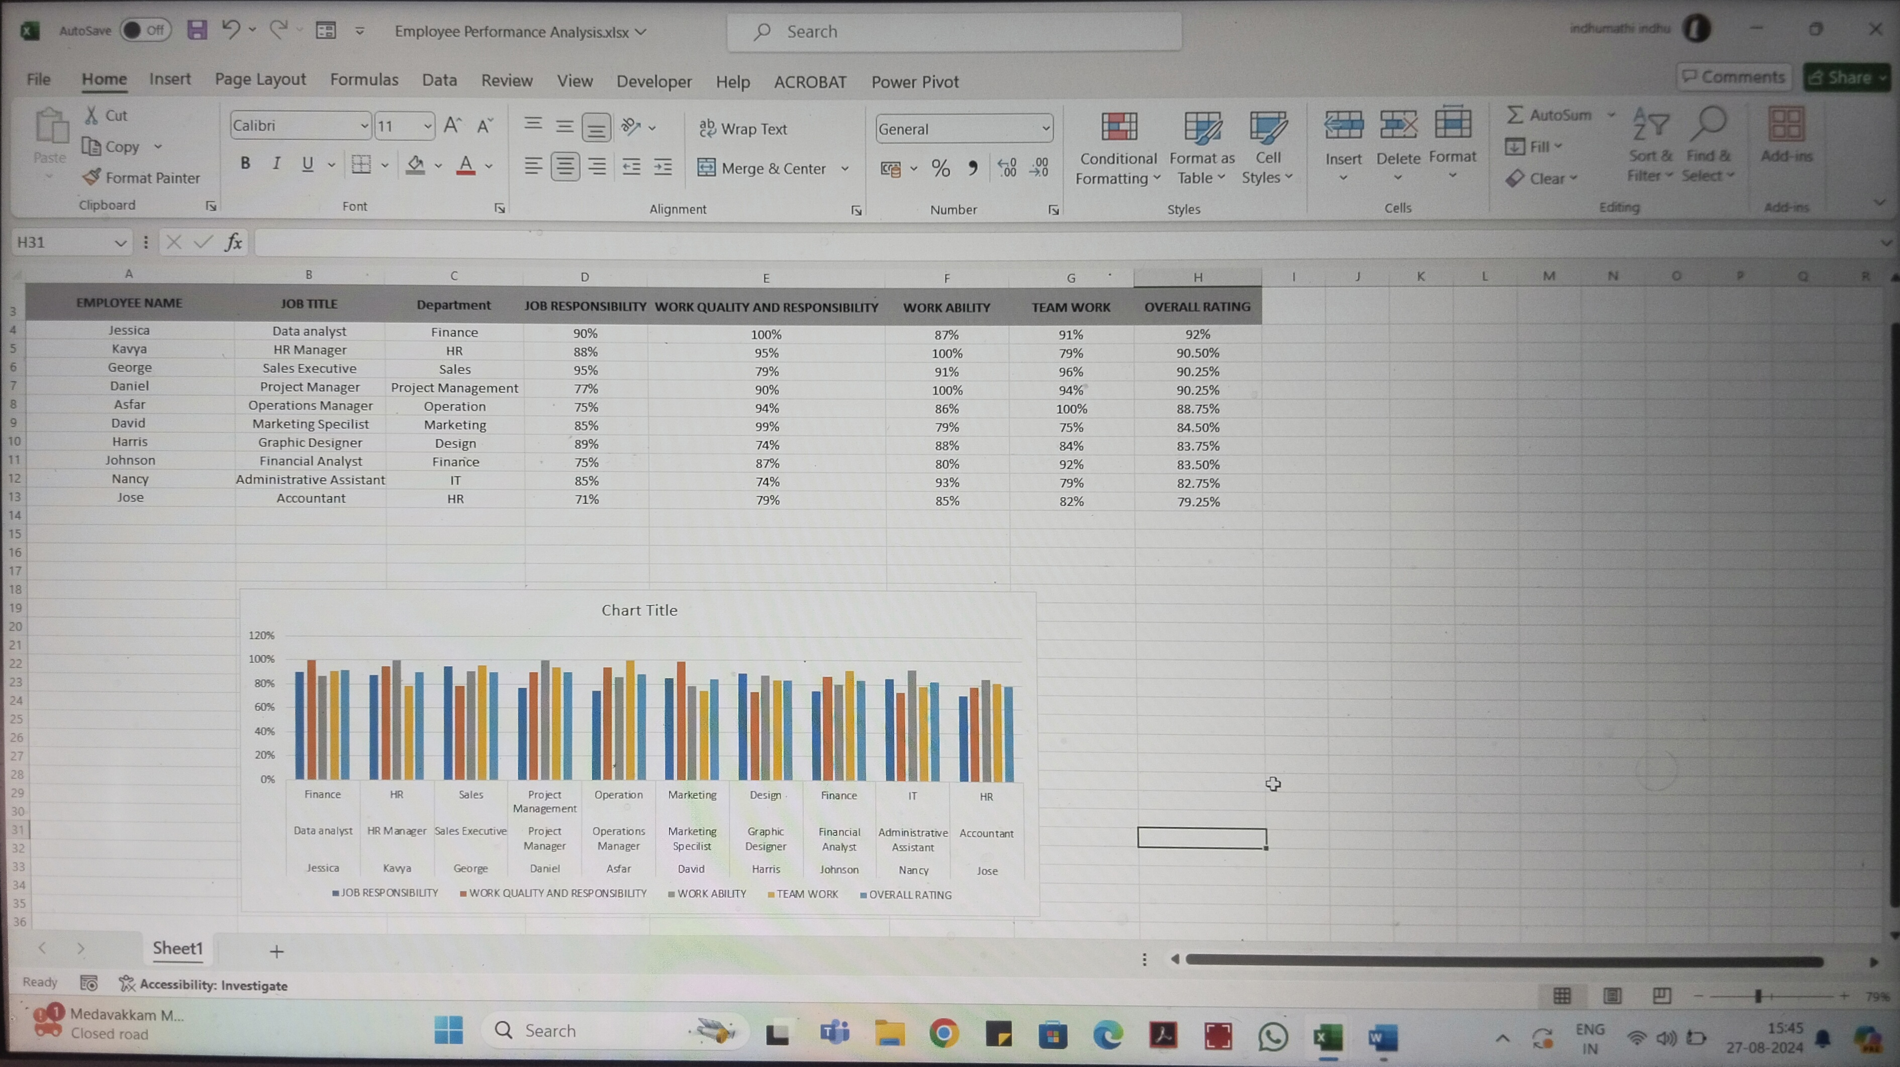

Slide 10
Dataset Description
For employee performance analysis in Excel, include columns such as Employee ID, Name, Department, Position, Performance Rating, KPI Scores, Attendance, Training Hours, Goals Achieved, Feedback Scores, Salary, and Tenure. Use Excel's functions and charts to analyze and visualize the data.

Slide 11
THE "WOW" IN OUR SOLUTION
To create a "wow" factor in your Excel solution for employee performance analysis, use interactive dashboards with dynamic charts and advanced formulas. Automate reports with macros and include data validation to ensure accuracy. Offer customizable views and scenario analysis to explore different performance outcomes effectively.
3/21/2024 Annual Review
11

Slide 12
MODELLING
To model employee performance in Excel, start by setting up a table with columns for Employee ID, Name, Department, Date, and relevant KPIs. Input performance data into this table, ensuring accuracy. Use Excel functions like `AVERAGE()` and `STDEV()` to analyze the data, and create PivotTables and charts to visualize trends and comparisons. Develop a performance score formula by weighting different KPIs to assess overall performance. Finally, build a dashboard to provide an interactive view of performance metrics and trends for easier analysis and decision-making.
12

Slide 13
RESULTS
To analyze employee performance in Excel, gather and organize data on key metrics, use formulas for calculations, apply conditional formatting for visual insights, and create charts to visualize trends. Summarize findings with PivotTables and generate reports to inform decisions.
13

Slide 14
conclusion
The performance analysis reveals key trends and patterns, such as consistent high performance in certain areas and opportunities for improvement in others. Key strengths include [specific strengths], while weaknesses include [specific weaknesses]. Recommendations include [specific actions], and the next steps involve [further actions]. Overall, the analysis provides valuable insights to enhance performance and align individual contributions with organizational goals.

